Slide 1
DATA 301 Introduction to Data Analytics Command Line
Patrick Epman
University of British Columbia
patrick.epman@ubc.ca
Slide set presentation courtesy of Dr. Ramon Lawrence and Dr. Irene Vrbik

Slide 2
Why learn the Command Line?
The command line is the text interface to the computer.
Understanding the command line allows you to interact with the computer in ways that you often cannot with the user interface.
The command line is commonly used for scripting and automation of tasks and when accessing remote systems.

Slide 3
What is the Command Line?
The command line is the text interface to the computer that accepts commands that the computer will execute. These commands include:
starting programs
navigating directories and manipulating files
searching, sorting, and editing text files
system and environment configuration
The command line is part of the operating system, which is software that manages your computer including all devices and programs.
Common operating systems include Windows, Mac OS, and Linux/Unix.

Slide 4

Windows Command Line
The command line on Windows dates back to the original Microsoft operating system called DOS (Disk Operating System) in 1981.
This command line interface is still part of all modern Windows operating systems and is accessible as the "Command Prompt".
It is commonly used for system administration and scripting.

Slide 5
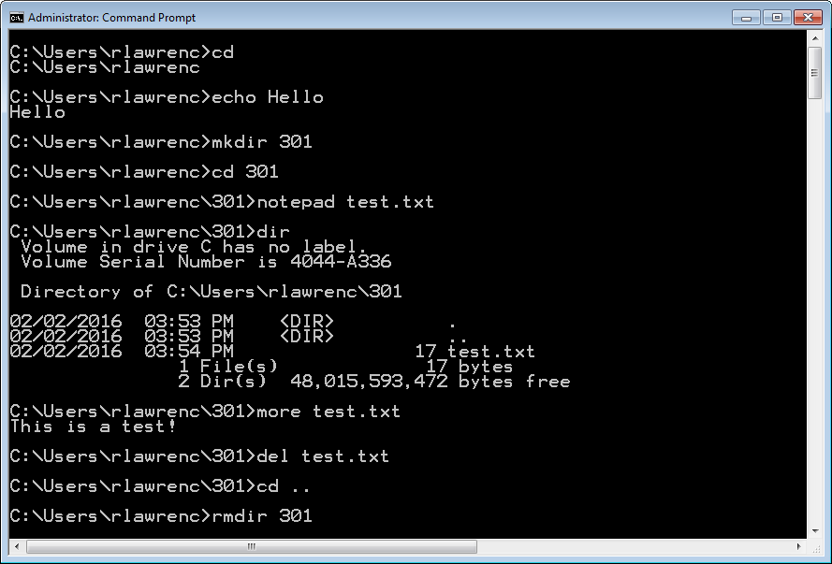
Command Line - Windows
Notes:
cls
cd
echo Hello
mkdir 301
cd 301
notepad test.txt
In notepad write: This is a test!
dir
more test.txt
del test.txt
cd ..
rmdir 301
Note: "ls", "rm", are not default commands found on Windows, but can be added through extensions. These extensions commonly come from installing Git (which will also install common bash utilities), as well as MinGW's MSYS, which provides similar functionality. Cygwin is another common place people get bash utilities from.

Slide 6
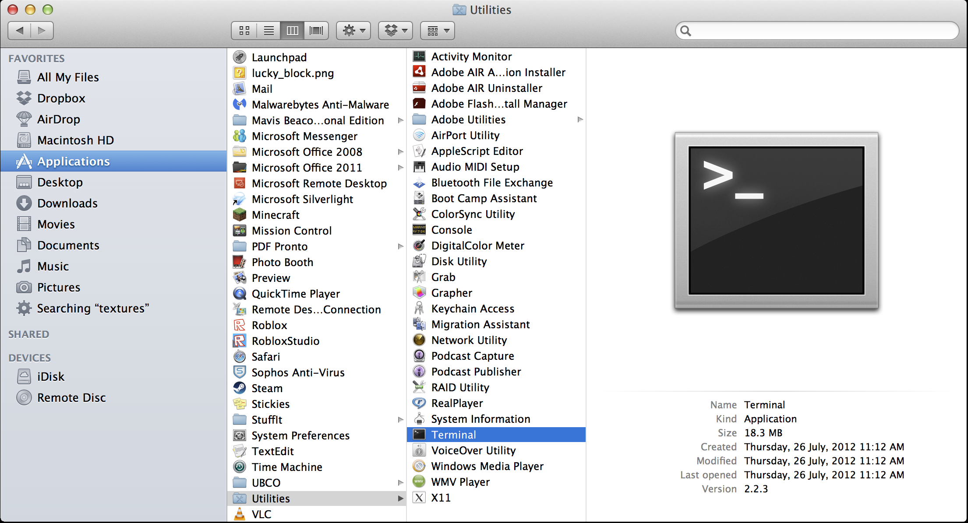
Mac OS Command Line
The command line for Mac OS uses the same commands as Linux. It can be opened using Finder then Utilities then Terminal.

Slide 7
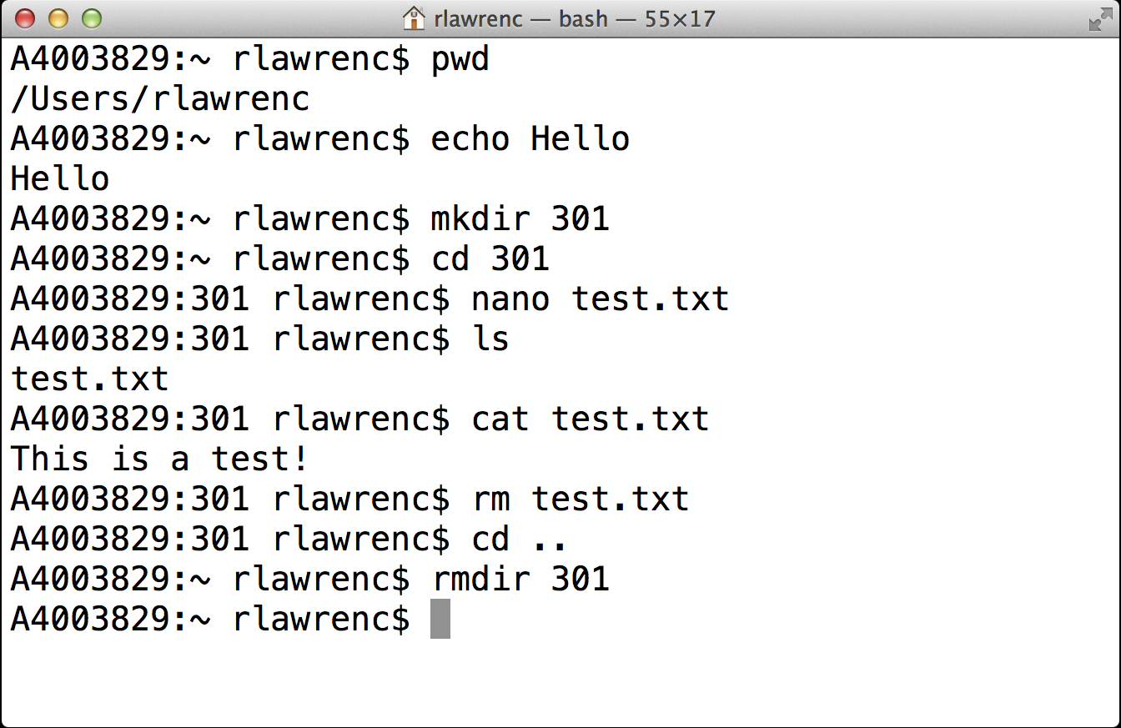
Command Line – Mac/Linux
Notes:
clear
pwd
echo Hello
mkdir 301
cd 301
notepad test.txt
In notepad write: This is a test!
ls
cat test.txt
rm test.txt
cd ..
rmdir 301
rm –r 301

Slide 8
Entering a Command
Enter a command at a prompt.
The prompt may be a > or a $ or customized by the user.
Press ENTER to execute the command.
On Windows, commands are mostly case-insensitive while on Mac/Linux they are case-sensitive.

Slide 9
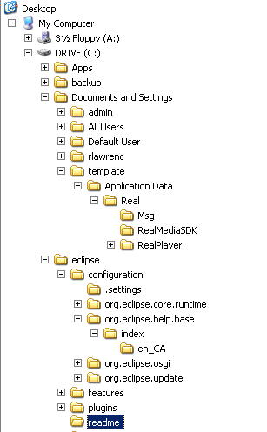
File System
The file system organizes data on a device as a hierarchy of directories and files.
Each folder (directory) has a name and can contain any number of files or subdirectories.
Each file has a name.
The user can change (navigate) directories in the hierarchy.

Slide 10
Absolute versus Relative Paths
The root of the file system is the directory "/".
There is only one root of a directory hierarchy.
A path to a new location (from your current location) can be specified as an absolute path from the root:
cd /Users/rlawrenc/301/folder
or a relative path from your current location:
cd 301/folder
To back up one directory level, use the command: cd ..

Slide 11
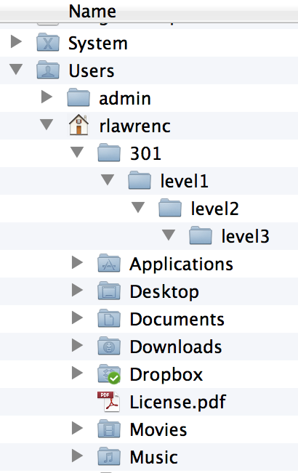
Absolute versus Relative Path Question
Question: Given this directory hierarchy and that the user is currently in the directory level2 and level1 directory contains a file test.txt. How many of the following statements are TRUE?
1) A relative path to change to directory 301 is ..
2) Absolute path to test.txt is /Users/rlawrenc/301/level1/test.txt
3) Relative path to test.txt is ../test.txt
4) Relative path to test.txt is different if user was currently in level3 directory.
5) There is only one root of the directory hierarchy.
A) 0 B) 1 C) 2 D) 3 E) 4
Notes:
Answer: E
True: 2, 3, 4, 5
Note: Make clear that this is not the entire folder structure (Users is just below root).
11

Slide 12
Commonly Used File Navigation Commands
 | Windows | Mac OS and Linux
List contents of directory | dir | ls
Change directory | cd 301 | cd 301
Print working directory | cd | pwd
Make a directory | mkdir 301 | mkdir 301
Remove a directory | rmdir 301 | rmdir 301
Rename a file | ren old.txt new.txt | mv old.txt new.txt
Remove a file | del file.txt | rm file.txt
Copy a file | copy src.txt dest.txt | cp src.txt dest.txt
Notes:
Note the rm –r variant to recursively remove files and subdirectories.
Note there is a rename command on Linux but it is more complicated as it uses regular expressions:
rename (option) 's/oldname/newname' file1.ext file24.ext

Slide 13
Commonly Used Text Related Commands
 | Windows | Mac OS and Linux
Open a text editor | notepad | nano
Echo output | echo Hello | echo Hello
Output contents of a file | more file.txt | cat file.txt
Search text files | find | grep
Sort text files | sort | sort
Notes:
Note: Mac OS does not support double-quotes around text for echo. It generates an error. Works fine on Windows (echos with quotes) and Linux (just echos data without quotes).

Slide 14
Wildcards
A wildcard character allows for matching file names with more flexibility.
The ? represents any one character in a file name.
Example: file?.txt would match file1.txt.
The * (asterisk) matches any number of characters (including zero).
Example: *.txt would match anything ending with .txt (a.txt).
Notes:
? must match exactly one character.
* can match zero or more characters.

Slide 15
Navigating the Command Line
 | Windows Key | Mac OS Key
Previous command in history | Up | Up
Next command in history | Down | Down
First command in history | PageUp
Last command in history | PageDown
Move to start of line | Home | Ctrl+A
Move to end of line | End | Ctrl+E
Auto-compete file name | Tab | Tab
Notes:
Other windows:
- Esc - Clears the current command
F7 - Displays the command history in a scrollable pop-up box
F8 - Displays commands that start with characters currently on the command line
Alt+F7 - Clears the command history

Slide 16
Pausing or Cancelling Commands
To pause a command:
Windows: Press Ctrl+S or the Pause key. To resume, press any key.
Mac: Control+Esc or Command+.
To cancel a command, press Ctrl+C or Ctrl+Break.
The command is canceled, and the command prompt returns.
However, any actions performed before the cancel are not undone.

Slide 17
Command Shortcuts Question
Question: How many of the following statements are TRUE?
1) To cancel a command, press Ctrl+X.
2) To go to the next command in the history, press Up arrow.
3) This wildcard expression te*a?.txt matches tea12.txt.
4) The command to change a directory is pwd.
A) 0 B) 1 C) 2 D) 3 E) 4
Notes:
Answer: A
All wrong.
17

Slide 18
Try it: Navigating Directories with Commands
Question: Using a terminal window on your computer, perform the following actions:
Create a directory called 301.
Change into the directory 301.
Echo I am awesome!
Show your current directory (print working directory).
Create a text file called message.txt with a message in it.
List the contents of your directory.
Rename the file message.txt to test.txt. Verify the name change.
Delete the test.txt file.
Change directory to directory above 301.
Delete directory 301.
Notes:
Windows:
mkdir 301
cd 301
echo I am awesome!
cd
notepad message.txt
dir
ren message.txt test.txt
dir
del test.txt
cd ..
rmdir 301
Linux/Mac:
cd 301
echo I am awesome!
cd
nano message.txt
ls
mv message.txt test.txt
ls
rm test.txt
cd ..
rmdir 301

Slide 19
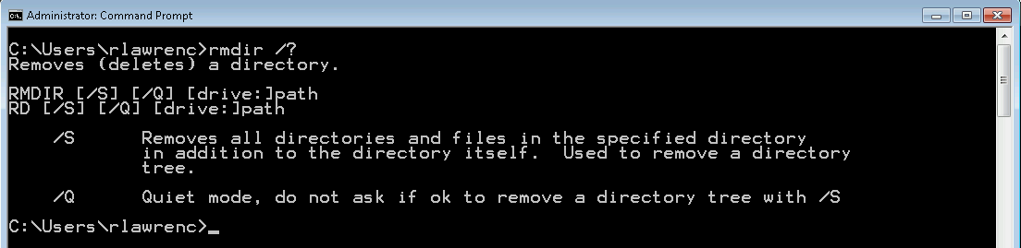
Command Arguments
A command can take arguments that changes its behavior.
Example: Path was an argument for the cd command. e.g. cd 301
On Windows, commands also can be modified by a switch (or extension) which is usually a slash then a letter (e.g. /S).
To find out what is available, run the command with: /?

Slide 20
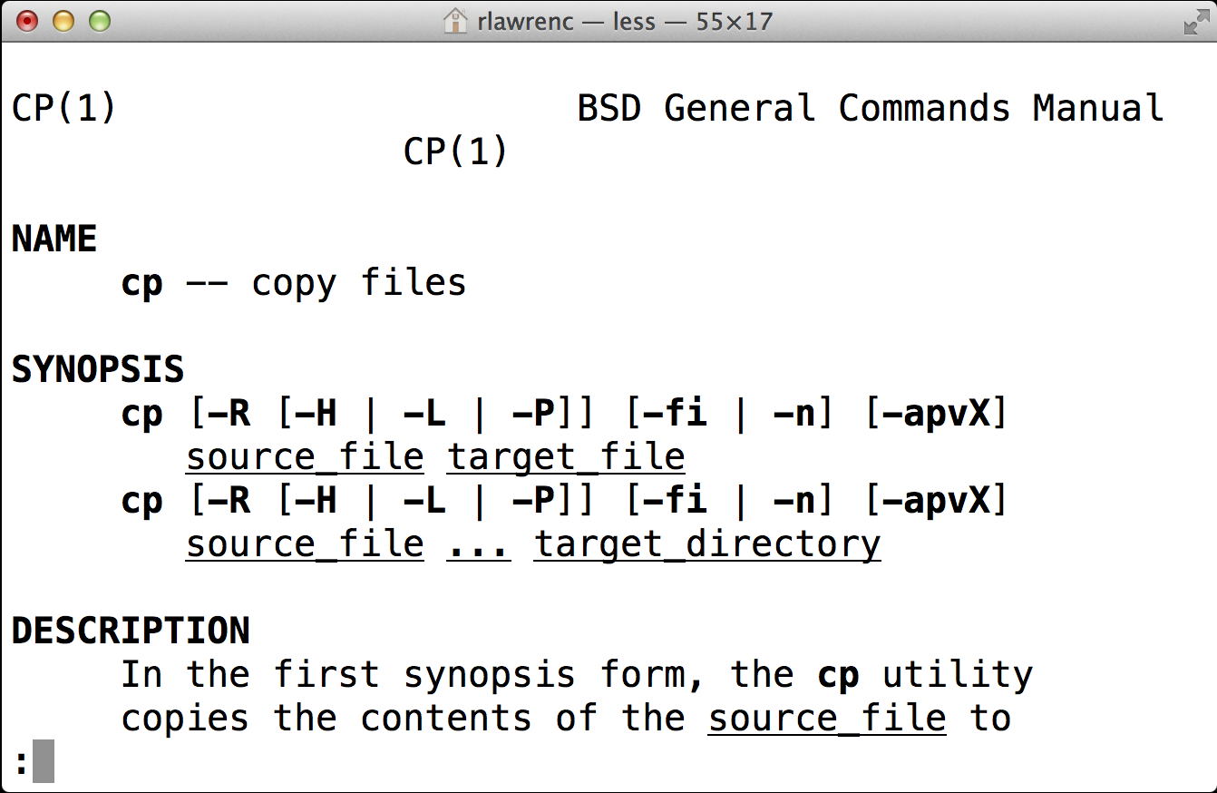
Command Arguments – Mac/Linux
On Mac/Linux, arguments are separated by spaces and begin with -.
An explanation of arguments can be found by using man then the command name. Example: man cp

Slide 21
Standard Input, Output, and Error
Standard input (stdin) is the default input device (usually a keyboard) into the terminal.
Standard output (stdout) is the location where output is sent after a command is run. The default is the terminal window.
Standard error (stderr) is the location where error messages are displayed (typically the terminal window).

Slide 22
Redirecting Input
By default, a command gets its input from standard input and outputs results to standard output.
A command can get its input from the output of another command by using the pipe (|) symbol. Example:
cat test.txt | wc
Also can use redirect input (<) to send input to a command. Example:
cat < test.txt
Note that can chain together multiple pipes.
Note the example commands are Mac OS/Linux only: wc is not on Windows.
Notes:
wc – word count
Another one: ls | sort
Note that cat < test.txt
is the same as:
cat test.txt

Slide 23
Redirecting Output
Redirect output using > which will overwrite the file:
sort test.txt > sorted.txt
Use >> to append to the existing file:
sort test.txt >> sorted.txt
Notes:
Windows does have a sort so these two commands do work.

Slide 24
Redirection Summary
 | Symbol
Redirect input | <
Redirect output | >
Redirect output (append) | >>
Pipe output to input of next command | |

Slide 25
Escape Symbol
An escape symbol is used when a command requires input that contains a character with a special meaning. The escape symbol indicates this character is data not part of the command.
On Windows, the caret (^) indicates that whatever character that follows it is data rather than part of the command. Example:
cp test.txt a^&b.txt
On Linux, use the backslash (\).
This is especially common when dealing with spaces in a file name. The other way to handle file names with spaces is to enclose them in double quotes:
cp test.txt "c:\program files\file spaces.txt"
Notes:
Note that double quotes and single quotes have special meaning in BASH:
http://wiki.bash-hackers.org/syntax/quoting

Slide 26
Environment Variables
Environment variables allow for customization and control of the command and system environment.
Current variables are seen using the set or env command.
Important variables:
$PATH – list of directories where commands/applications will be found
$HOME – user home directory
Notes:
$PATH (Linux) or Path (Windows)

Slide 27
Finding Text in Files
The grep command allows for searching for text in files that match a pattern (Mac/Linux only, find on Windows).
grep stands for "global regular expression print"
Search is case-sensitive (use –i for case-insensitive) and can contain regular expressions.
Example:
grep er *.txt
- search for er in any file that ends in .txt
Windows: find "er" *.txt
Notes:
grep –i will be case-insensitive
grep –R will search all files in directory

Slide 28
Batch Files
A batch program (also commonly called a batch file or command file) is a text file that contains a sequence of commands to be executed.
You define the sequence of commands, name the sequence, and then execute the commands by entering the name at a command prompt. Any action you can take by typing a command at a command prompt can be encapsulated in a batch program.
In Windows files typically end in .bat or .cmd and on Mac/Linux with .sh.
Batch files can take arguments like other commands.
Notes:
On Windows, parameters accessed using: %1, %2, etc.

Slide 29
Connecting to Another Computer using SSH
Secure shell or SSH is a protocol allowing remote login to other machines to execute commands.
The network communication is encrypted for security.
An open-source program on campus is Putty.
Using SSH allows you to connect and execute commands on another machine even when you do not have physical access to that machine.
SSH may be used to send or retrieve data from other computers for analysis.
Notes:
On mac:
ssh –l data301 cosc304.ok.ubc.ca

Slide 30
Try it: Using Batch Files
Question: Using a terminal window on your computer, create a batch file that performs these actions:
Before creating the batch file, create a file called numbers.txt that has the numbers one, two, three, …, ten.
In the batch file, called myscript.bat (or .sh):
Write a command to sort numbers.txt and output as sorted.txt.
Write a command to output the word count on numbers.txt to count.txt.
Write commands to take numbers.txt and append its data three times into the file output.txt.
Use grep to search for "e" in output.txt and write results as file search.txt.
Output the contents of sorted.txt, output.txt, and search.txt .
Run your batch file.
Notes:
1) Sort:
sort numbers.txt > sorted.txt
2) Word count (only works on Mac/Linux):
wc numbers.txt > count.txt
3) Append three times:
more numbers.txt > output.txt
more numbers.txt >> output.txt
more numbers.txt >> output.txt
4) Grep (Mac/Linux):
grep e output.txt
find "e" output.txt
5)
more sorted.txt
more output.txt
more search.txt

Slide 31
Conclusion
The command line is the text interface to the computer that accepts commands that the computer will execute including running programs, manipulating files, and running scripts.
The command line allows for automation and more control than may be available in the user interface. It may also be the only way to interact with the machine if connecting via SSH.
The command environment allows for redirecting the standard input and output using input/output redirection and pipes.

Slide 32
Objectives
Define command line and list some of its uses
Explain the purpose of an operating system
Know how to open the command line window on Mac OS and Windows
Be able to enter commands and stop them
Define: file system, folder, file
Explain the difference between an absolute and relative path
Use command line shortcuts to save time
Be able to match wildcards involving ? and *
Be able to cancel a command
Explain standard input, standard output, and standard error
Be able to use input and output redirection and pipes (?, >, < , >>)
Explain the reason for an escape symbol
Define and explain the purpose of environment variables.

Slide 33
Objectives (2)
Be able to use grep to search text files.
Explain the purpose of a batch program.
Be able to connect to another machine using SSH.

Slide 34
Bonus Tips and Tricks
While we did discuss the importance of command line and why it is useful, there are some hidden tricks that are unknown by most that can make command line even more useful
These tricks will work on Windows 10, and most of them will carry over to their older versions
Most of these tricks will only work on Windows, but there are some that will work on both Mac or Linux (GNU/UNIX), and some that are GNU/UNIX only
Full video explaining some of the hidden tricks
https://www.youtube.com/watch?v=7yW6Ybj6tOk

Slide 35
Properties of Command Prompt
You can adjust properties of the command window by right-clicking the title bar, and then clicking “Properties”
From here, you can change the font, color, and other properties
You can also set certain defaults by clicking “Defaults”, making these changes permanent on start up

Slide 36
Changing the Color of the Screen and Text
If you do not like the classic black and white scheme of the command window, you can actually change the colors using the “color” command
The color command takes two arguments (color 12); first digit is the color of screen, second digit is screen color; arguments are color-coded 0-9 and a-e
Typing “color /?” gives you full help on the command
C:\users\12345678\> color a # black screen with green text (Matrix-like theme)
C:\users\12345678\> color 1f # blue screen with white text (80’s OS style)

Slide 37
Prompt Command
Prompt command changes the directory listing with a code word
Typing “prompt hello” will make text before prompt “hello”, typing “prompt” alone after command will restore directory listing
C:\users\12345678\> dir “DATA 301”_ # before
hello dir “DATA 301”_ # after
This does seem unambiguous, but typing prompt /? gives you full help on the command, and gives you more options for the prompt, such as Windows version being used ($V), current drive ($N) , date ($D), and even time ($T)

Slide 38
Prompt Command (2)
My favorite example:
C:\users\12345678\> _ # before
C:\users\12345678\> prompt $T $S $P$G_ # executing prompt command
18:16:21.56 C:\users\12345678\> _ # after
Very useful for system administration settings where security needs are very high, as there are time stamps on every command executed.
Try it yourself! Begin with “prompt /?” and choose your own prompt customization.

Slide 39
Modifying Command Prompt with Registry Key
The trick I showed you earlier only works while CMD is running; if you reset or close the program, it goes away
If you want it permanently, you can do that by changing the computer registry through the “Registry Editor”.
WARNING: I do not recommend you trying this, as modifying the wrong settings in the registry can ruin the version of Windows on your computer, and you’ll have to reinstall it, and maybe even lose your data. I will NOT explain you how to do this for safety, security, and liability reasons.
For the curious student, you can watch the video linked on Slide 34 that will go in full depth on how it’s done. BE FORWARNED, if you try this and you ruin your version of Windows, NEITHER I NOR the video creator are responsible.

Slide 40
Changing the Title of the Command Window
You could change the command prompt window with the “title” command
C:\users\12345678\> title MY WINDOW_ #MY WINDOW on the title bar
Very useful when you need to label a specific task to be executed
Try it with your name!
You can change the title permanently using the “Registry Editor”. Again, I don’t recommend doing it, but the video will tell you how it’s done.

Slide 41
Command History
You will remember that pressing the arrow key will give you the previous command typed in earlier
Typing in “doskey /history” will show previous command entered
C:\users\12345678\> doskey /history_
You can also hit “F7”, and it will give you a menu of old commands
This command will work with Windows only.

Slide 42
Copying Commands
You might remember that hitting “Ctrl + C” will cancel a running command, but then how do you “copy and paste”?
Copying text in CMD is done by highlighting the text, then right clicking; pasting is simply done by using good old “Ctrl + V” (paste).
This trick works on both Windows and Linux

Slide 43
CMD Shortcuts
Let’s say that you want to reach a particular directory, but typing it in command prompt is tedious and takes forever and you want to avoid that
In Windows, once you open “My Computer” and once you are in your desired directory, you can type in “cmd” in the address bar and CMD will start up and begin at that particular directory
As a bonus, instead of typing, you can “drag and drop” directories in CMD, and it will automatically fill in the name and location for that file or folder

Slide 44
System File Checker
In Windows, there is an utility called the “System File Checker” which will look at computer files, check if they are corrupted, and repair them
Useful if you have issues with Windows misbehaving and/or you have errors due to corrupted files; not a failsafe method for all issues, but a good place to start
Will only work if you are the “administrator” on the computer (will NOT work on UBC computers)
C:\users\12345678\> sfc /? # help in regards of the command
C:\users\12345678\> sfc /scannow # begins the system file checker

Slide 45
Super User Commands
Some commands when are executed in Linux require super user function when executed to increase security
What requires this are updates, upgrades, importing of different libraries into Linux, and any other file that you want hidden behind a password
In order to use the “super user do” (sudo) commands, first you’ll need to create an admin password by typing “passwd”, and hitting the “Return” key; you will be then prompted for a password
A1234567: ~ pepman$ passwd_
Please Enter Password:_

Slide 46
Super User Commands (2)
NOTE: Once you set up your password, do NOT forget it, as you will be required to input it if you ever want to change it; if you forget it, you will essentially be locked out of your own computer
Now that you’ve setup your password, you can try to create a password protected file using “nano” (notepad) as discussed earlier
A1234567: ~ pepman$ sudo nano test-secure.txt_
Please Enter Password: _
Running code as superuser will always prompt you for the admin password, and opening and editing the “test-secure.txt” is password-protected.

Slide 47
Importing Programs and Libraries
Importing various code and other programs is done preferably through command line for Linux and to a certain extent for Windows as well
For Linux, the “apt-get” command is used, but will require “sudo”
For Windows, the “Get-AppxPackage” command is used for getting application packages
C:\users\12345678\> Get-AppxPackage -Name [Package Name] # Windows
A1234567: ~ pepman$ sudo apt-get [Package Name] # Linux
Please Enter Password: _

Slide 48
Removing Programs and Libraries
When you download and use a particular package or app, you may only use it for a certain amount of time and then not need it anymore, so it’s best to delete these files to avoid taking up unnecessary computer resources
Once you run the command you will be prompted if you are sure, and then the uninstall and deleting of the package begins
C:\users\12345678\> Remove-AppxPackage -Name [Package Name]_ # Windows
A1234567: ~ pepman$ sudo apt-get purge [Package Name]_ # Linux
Please Enter Password: _
Note that in Linux you can use “remove” instead of “purge”, but “remove” will only uninstall the package and not delete the code, unlike “purge” which deletes any file associated with the package.

Slide 49
System Version
You can find the exact version of the operating system you are using by using the “uname” command in Linux and “ver” in Windows; the strength of this command is allowing you to see if your OS version is new enough for a specific function, or to double check the version in case you get errors
A1234567: ~ pepman$ uname –a_ # returns the kernel and OS version
C:\users\12345678\> ver_ # returns Windows version

Slide 50
System Update
In Linux, to update your existing code libraries and programs the “update” clause is used; note that it requires super user command
A1234567: ~ pepman$ sudo apt-get update_
Please Enter Password: _ # can take about 5 mins
To update your existing operating system to the latest version, the “upgrade” clause is used; using “dist-upgrade” is recommended, as it fully deletes the old unused packages and frees up resources
A1234567: ~ pepman$ sudo apt-get dist-upgrade_
Please Enter Password: _ # can take over an hour

Slide 51
Internet Protocol Configuration
In Command Line, you can access Internet Protocol (IP) configurations using the following commands:
ipconfig (Windows)
ifconfig (Mac/Linux)
C:\users\12345678\> ipconfig _ # Windows
A1234567: ~ pepman$ ifconfig _ # Mac/Linux
Useful for your local network to find a local network adapter or even you default gateway
Also gives very useful information about what devices are connected to the network

Slide 52
Thank you
Any more questions?

